Slide 1
Optimal Control of Quadrotor Flight for Aircraft Inspection
Yufeng Sun
AEEM 6022, 2020

Slide 2

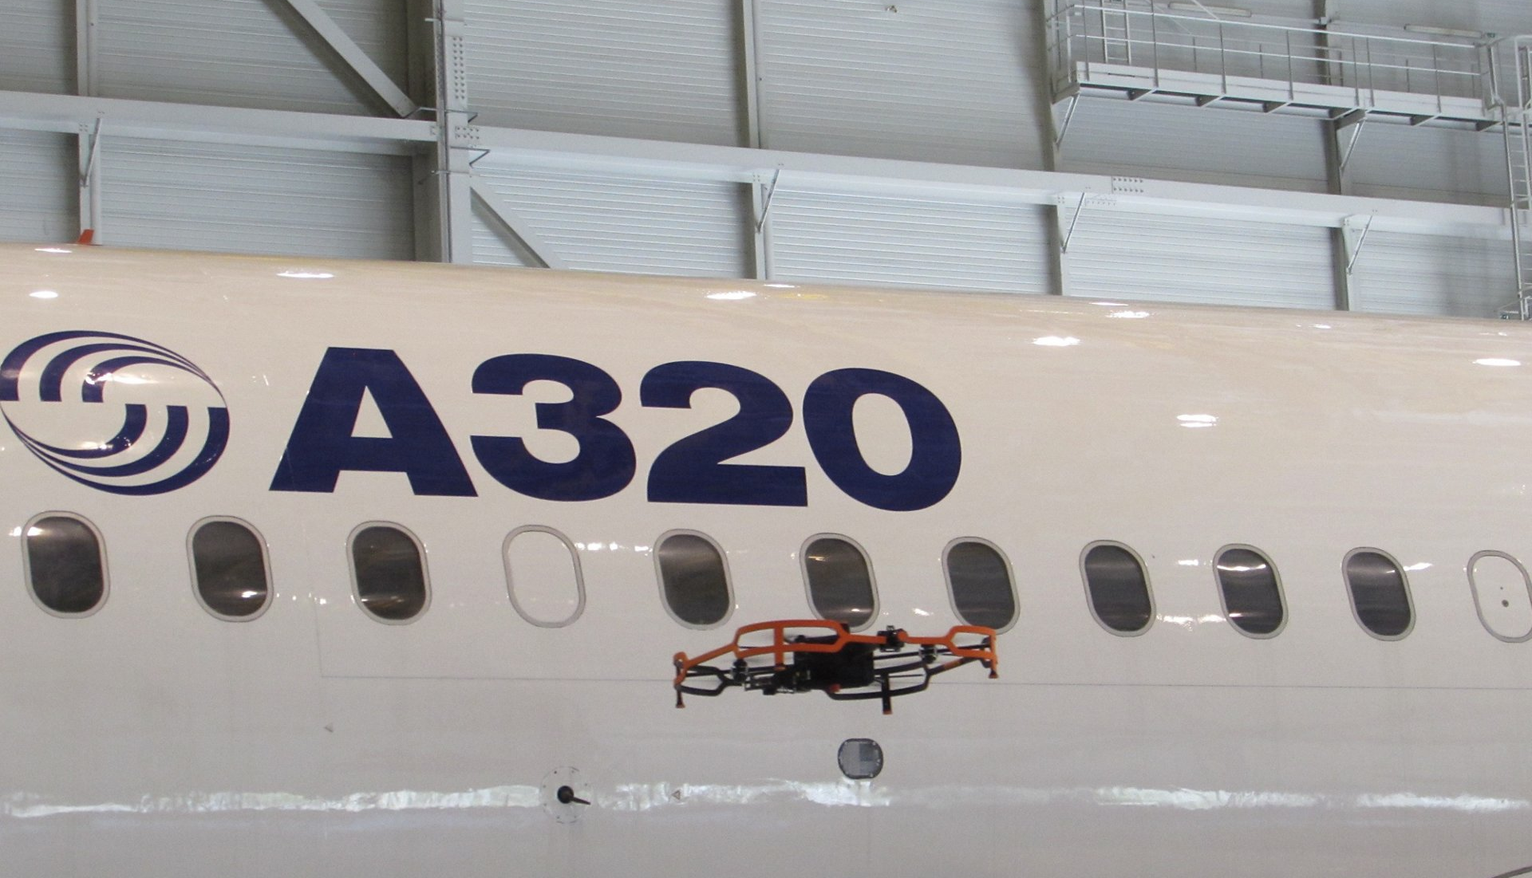
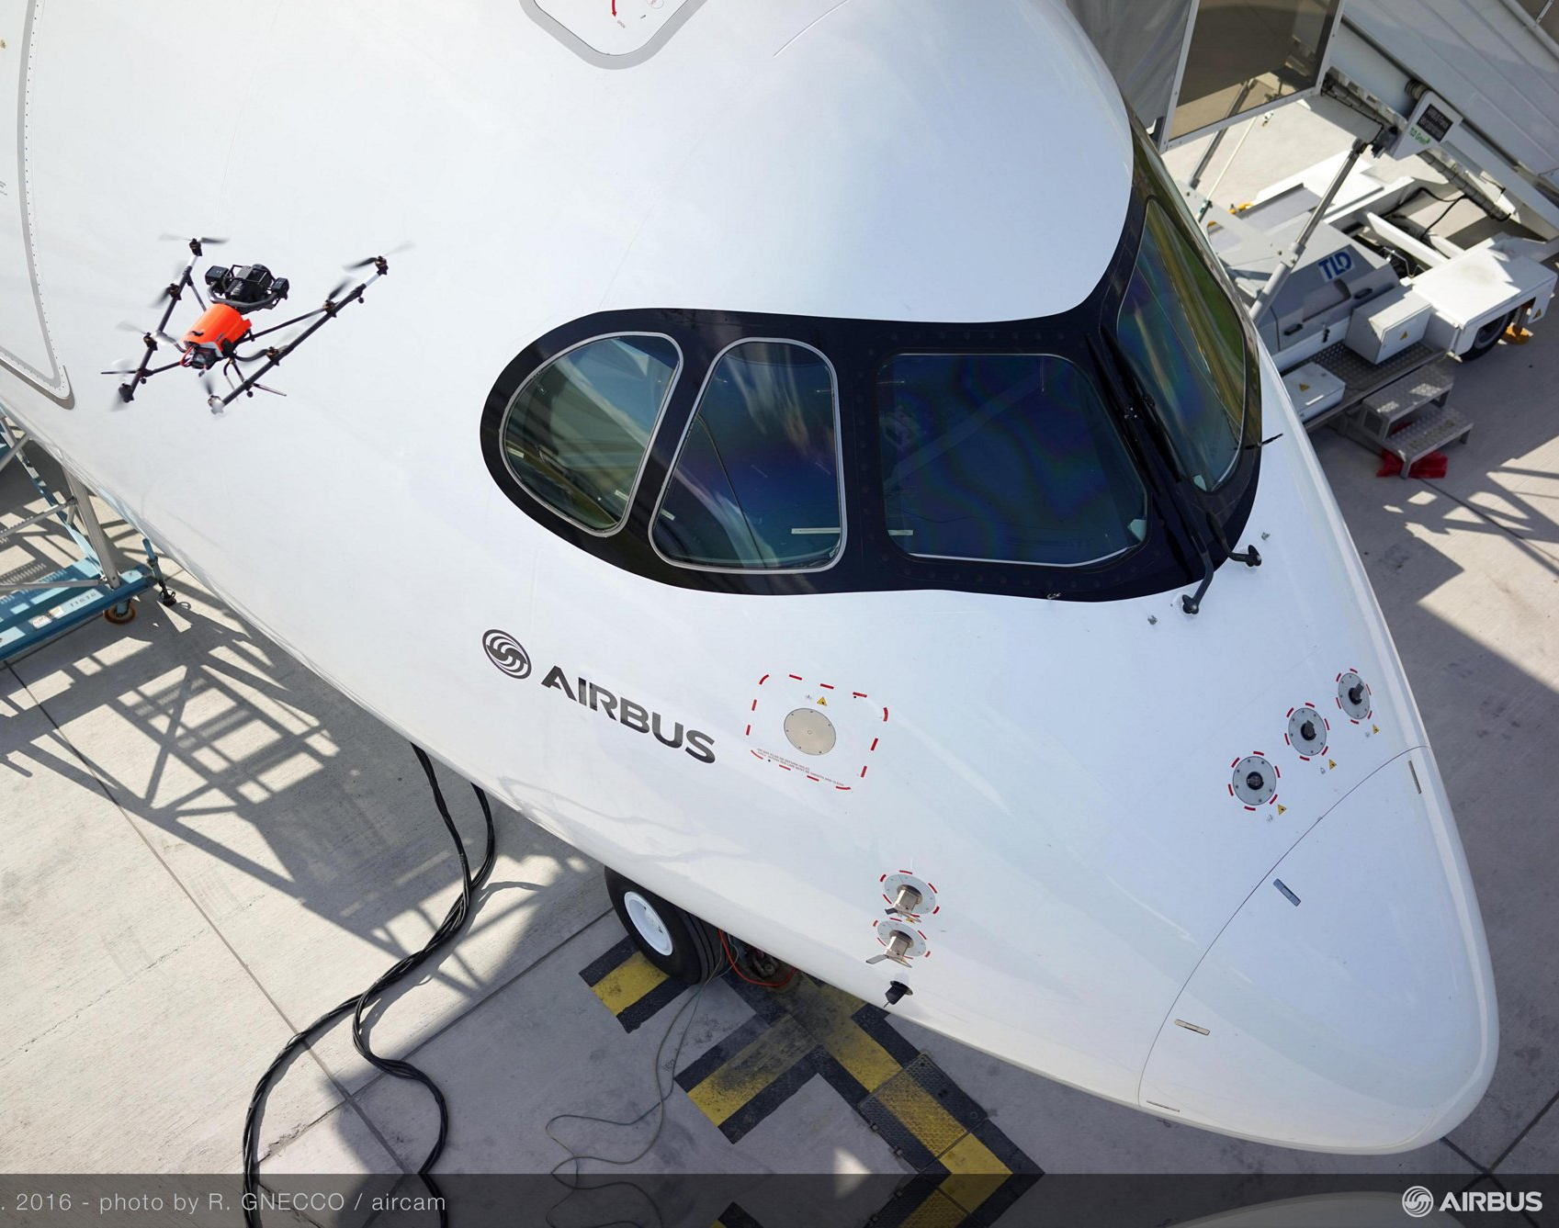
Visual Inspection of Aircraft with Drone
As an aircraft ages, frequent close inspection is mandatory which involves expensive manpower.
Applying drone inspection for aircraft leads to two game-changing advantages:
Easy and free positioning. A drone can photograph every square inch of an aircraft in equal detail. No corner of an aircraft is beyond the reach of a drone
Automatic problem identification. Machine learning and artificial intelligence enable algorithms that can assist in on-the-fly detection of aircraft problems.
Notes:
https://eleks.com/blog/drone-inspection-for-aircraft-maintenance-checks/

Slide 3
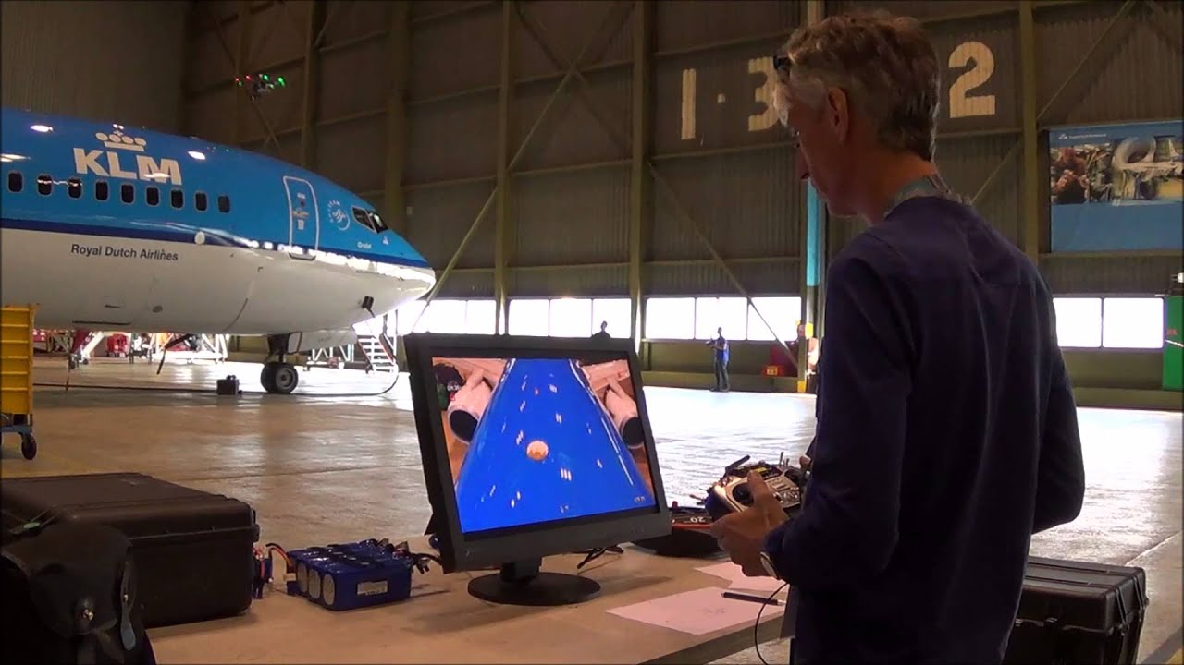
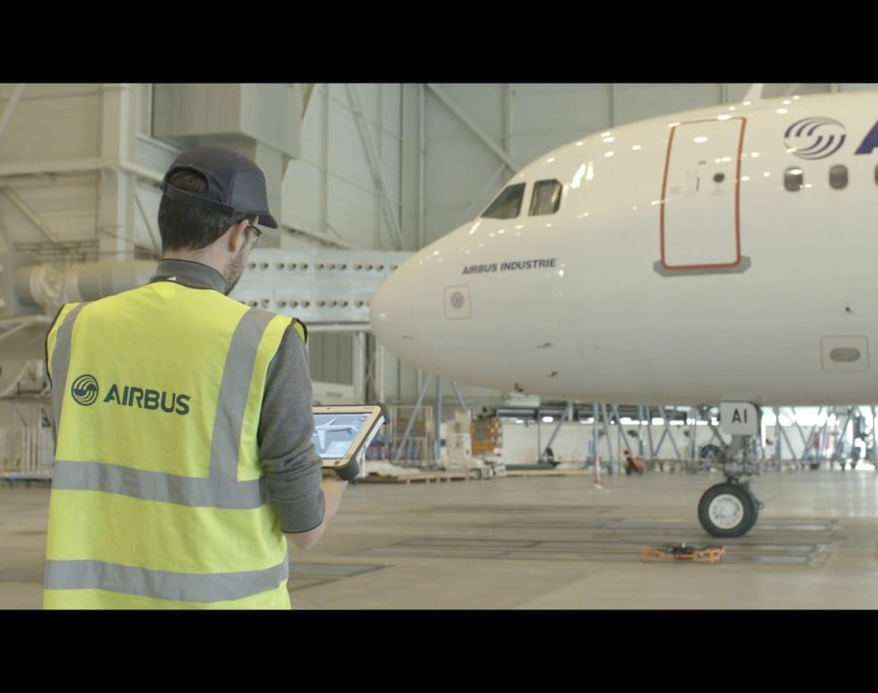
Challenges
Autonomous and Optimal Flight for full coverage inspection
The drone is manually controlled by skilled human operator
Flight time is limited due to the limited battery life

Slide 4
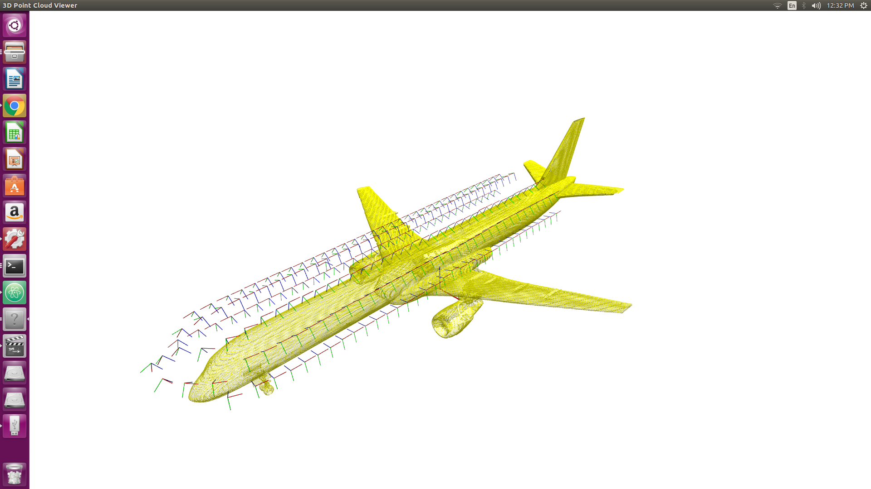
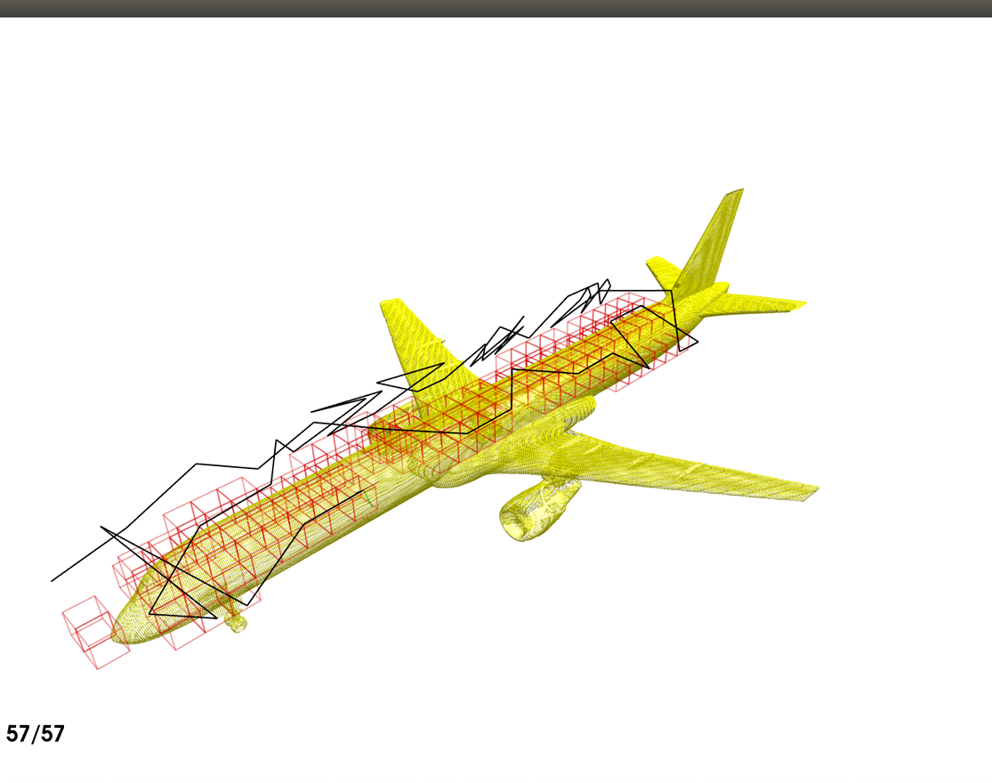
Inspection Path Planning with AI
Inspection path generation based on a point cloud model of the target aircraft
Generate enough number of candidate inspection points to cover the selected area
Use ML technique to find an optimal path contraining a sequence of least inspection points

Slide 5
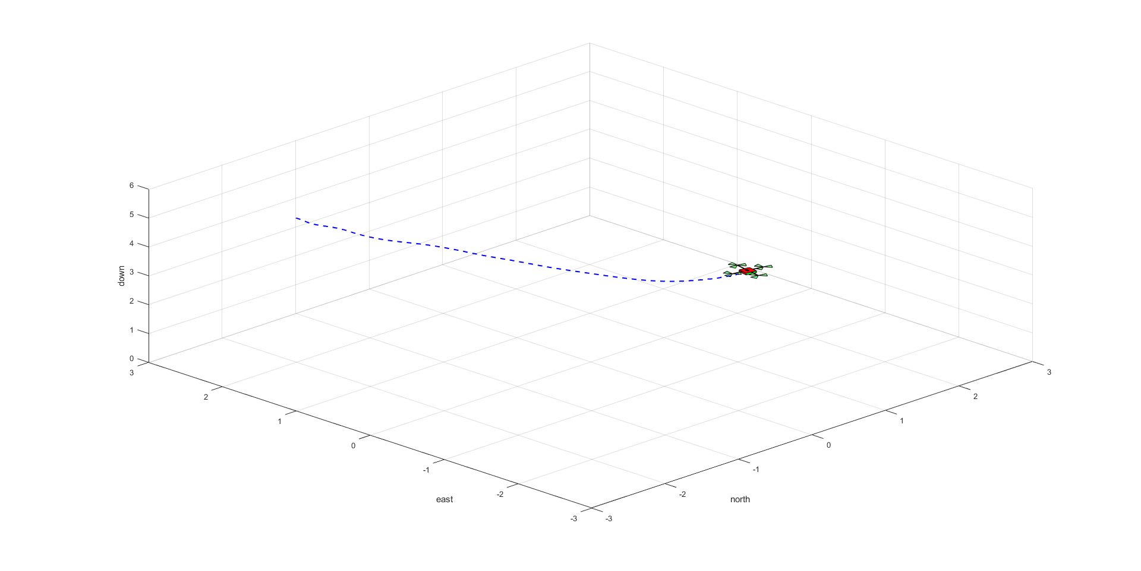
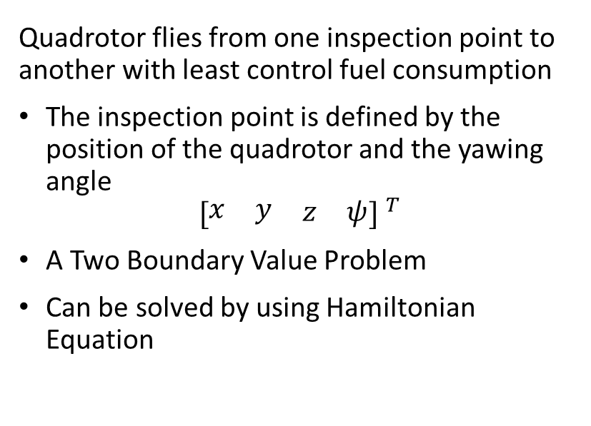
Quadrotor Optimal Flight
Quadrotor flies from one inspection point to another with least control fuel consumption
The inspection point is defined by the position of the quadrotor and the yawing angle
$${[\begin{matrix}\begin{matrix}x & y\end{matrix} & \begin{matrix}z & ψ\end{matrix}\end{matrix}] }^{T}$$
A Two Boundary Value Problem
Can be solved by using Hamiltonian Equation

Slide 6
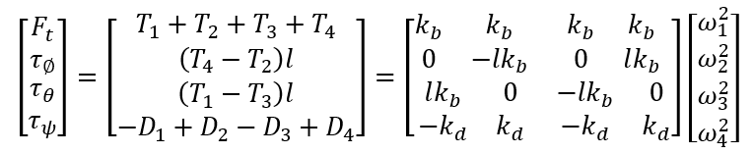
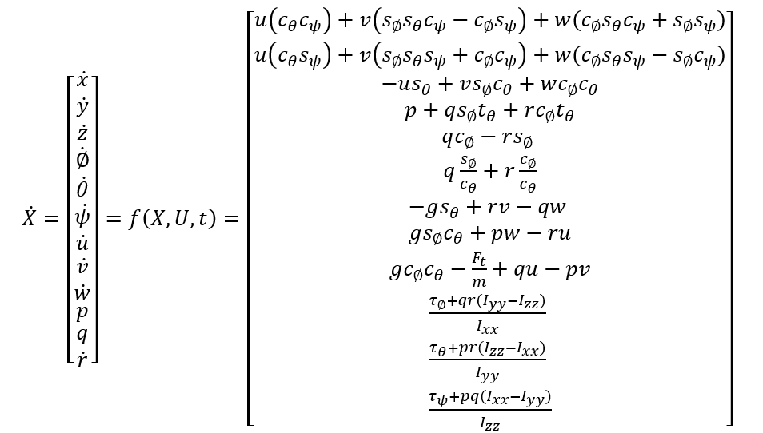
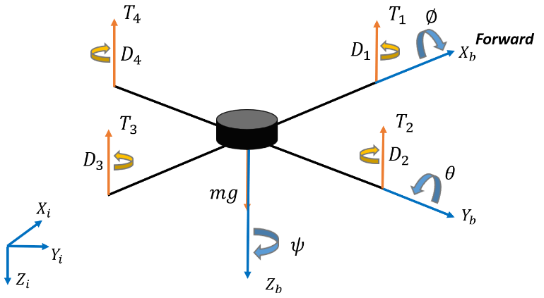
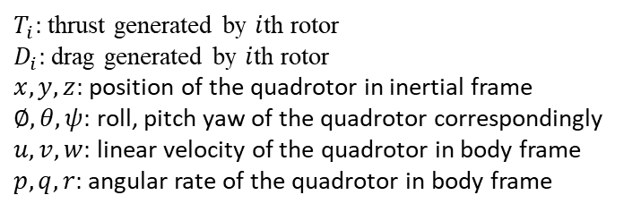
Dynamics Modeling of Quadrotor
Control inputs
Dynamics
$T_{i}:$thrust generated by $i$th rotor
$D_{i}:$drag generated by $i$th rotor
$x,y,z:$position of the quadrotor in inertial frame
$∅,θ,ψ:$roll, pitch yaw of the quadrotor correspondingly
$u,v,w:$linear velocity of the quadrotor in body frame
$p,q,r:$angular rate of the quadrotor in body frame

Slide 7
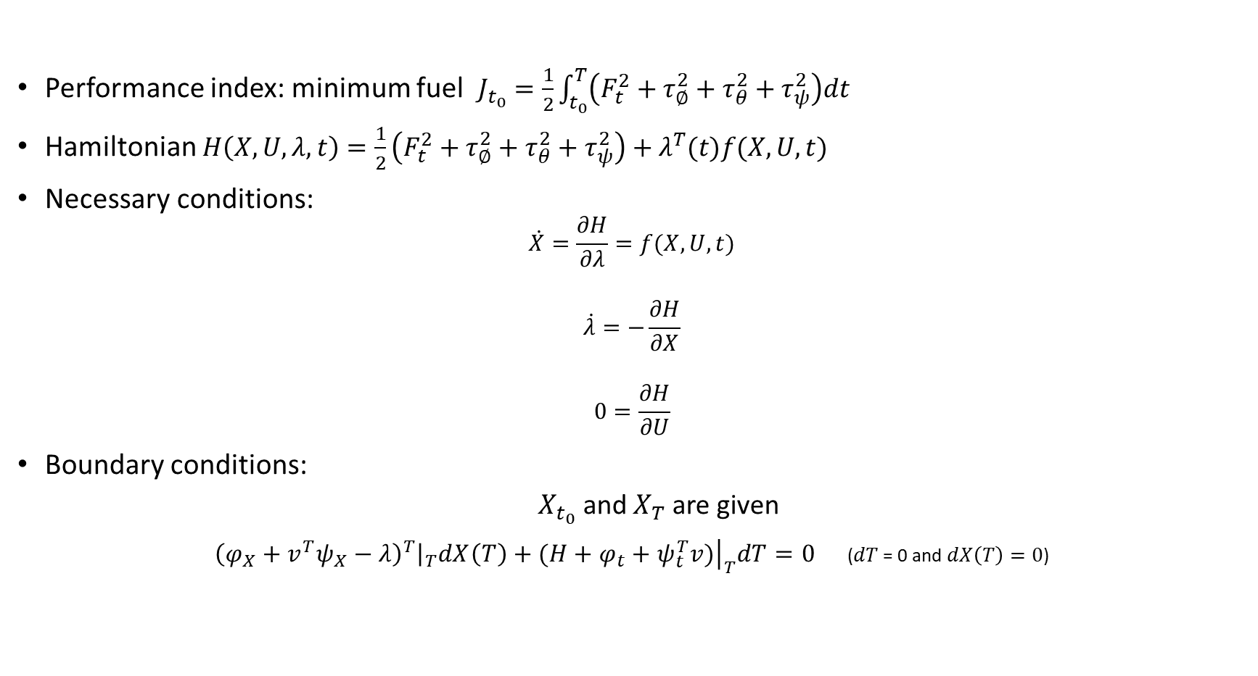
Hamiltonian Equations
Performance index: minimum fuel $J_{t_{0}}=\frac{1}{2}\int_{t_{0}}^{T}{\left(F_{t}^{2}+τ_{∅}^{2}+τ_{θ}^{2}+τ_{ψ}^{2}\right)dt}$
Hamiltonian $H\left(X,U,λ,t\right)=\frac{1}{2}\left(F_{t}^{2}+τ_{∅}^{2}+τ_{θ}^{2}+τ_{ψ}^{2}\right)+λ^{T}(t)f(X,U,t)$
Necessary conditions:
$$\dot{X}=\frac{∂H}{∂λ}=f(X,U,t)$$
$$\dot{λ}=−\frac{∂H}{∂X}$$
$$0=\frac{∂H}{∂U}$$
Boundary conditions:
$X_{t_{0}}$ and $X_{T}$ are given
${\left.{\left(φ_{X}+v^{T}ψ_{X}−λ\right)}^{T}\right|}_{T}dX\left(T\right)+{\left.(H+φ_{t}+ψ_{t}^{T}v)\right|}_{T}dT=0$ ($dT$ = 0 and $dX\left(T\right)=0$)

Slide 8
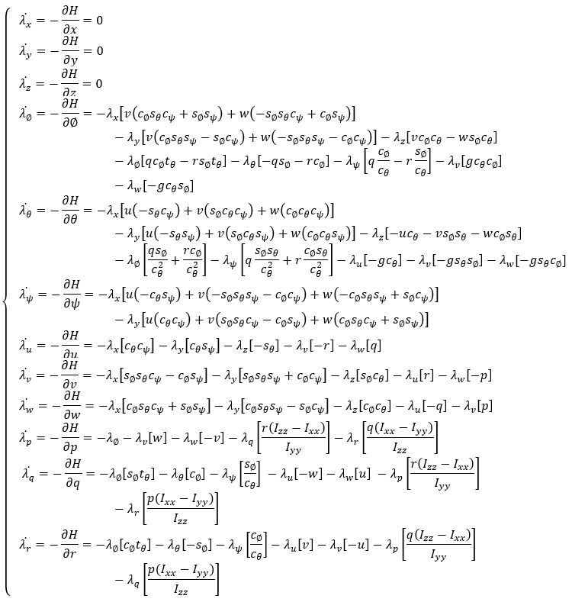
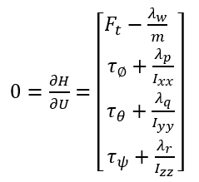
Co-state Conditions
Co-state conditions
Optimal controls

Slide 9
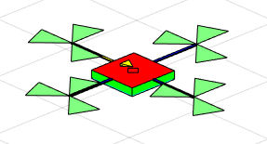
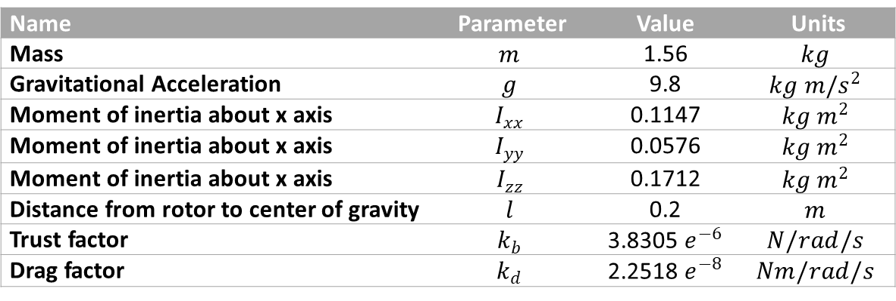
Simulation in Matlab
Name | Parameter | Value | Units
Mass | $$m$$ | 1.56 | $$kg$$
Gravitational Acceleration | $$g$$ | 9.8 | $$kg {m/s}^{2}$$
Moment of inertia about x axis | $$I_{xx}$$ | 0.1147 | $$kg m^{2}$$
Moment of inertia about x axis | $$I_{yy}$$ | 0.0576 | $$kg m^{2}$$
Moment of inertia about x axis | $$I_{zz}$$ | 0.1712 | $$kg m^{2}$$
Distance from rotor to center of gravity | $$l$$ | 0.2 | $$m$$
Trust factor | $$k_{b}$$ | 3.8305 $e^{−6}$ | $$N/rad/s$$
Drag factor | $$k_{d}$$ | 2.2518 $e^{−8}$ | $$Nm/rad/s$$
Solving BVP with bvp5c algorithm

Slide 10

Study Case 1
Vertical Ascending
$X_{t_{0}}={[\begin{matrix}\begin{matrix}0 & 0 & 0\end{matrix} & \begin{matrix}0 & 0 & 0\end{matrix} & \begin{matrix}0 & 0 & \begin{matrix}0 & 0 & \begin{matrix}0 & 0\end{matrix}\end{matrix}\end{matrix}\end{matrix}]}^{T}$
$X_{T}={[\begin{matrix}\begin{matrix}0 & 0 & −5m\end{matrix} & \begin{matrix}0 & 0 & 0\end{matrix} & \begin{matrix}0 & 0 & \begin{matrix}0 & 0 & \begin{matrix}0 & 0\end{matrix}\end{matrix}\end{matrix}\end{matrix}]}^{T}$
$T=10$

Slide 11

Study Case 2
Vertical Ascending and Yawing
$X_{t_{0}}={[\begin{matrix}\begin{matrix}0 & 0 & 0\end{matrix} & \begin{matrix}0 & 0 & 0\end{matrix} & \begin{matrix}0 & 0 & \begin{matrix}0 & 0 & \begin{matrix}0 & 0\end{matrix}\end{matrix}\end{matrix}\end{matrix}]}^{T}$
$X_{T}={[\begin{matrix}\begin{matrix}0 & 0 & −5m\end{matrix} & \begin{matrix}0 & 0 & 0\end{matrix}.5∗pi & \begin{matrix}0 & 0 & \begin{matrix}0 & 0 & \begin{matrix}0 & 0\end{matrix}\end{matrix}\end{matrix}\end{matrix}]}^{T}$
$T=10$

Slide 12

Study Case 3
Descending and Yawing
$X_{t_{0}}={[\begin{matrix}\begin{matrix}−2m & 2m & −5m\end{matrix} & \begin{matrix}0 & 0 & 0\end{matrix} & \begin{matrix}0 & 0 & \begin{matrix}0 & 0 & \begin{matrix}0 & 0\end{matrix}\end{matrix}\end{matrix}\end{matrix}]}^{T}$
$X_{T}={[\begin{matrix}\begin{matrix}2m & −1m & −2m\end{matrix} & \begin{matrix}0 & 0 & 0\end{matrix}.5∗pi & \begin{matrix}0 & 0 & \begin{matrix}0 & 0 & \begin{matrix}0 & 0\end{matrix}\end{matrix}\end{matrix}\end{matrix}]}^{T}$
$T=10$

Slide 13
Discussion
An initial guess (co-states values in this work) of the solution to a BVP using bvp5c must be provided.
This method cannot be applied to the online optimal control of aircraft inspection task, but an offline planning can be executed if all inspection points are known in advance.
A more useful task of optimal control in aircraft inspection will be studied in future, which is to find a control sequence to minimize the time of flying from one inspection to another while under saturated control inputs.

Slide 14
Thanks

